Slide 1
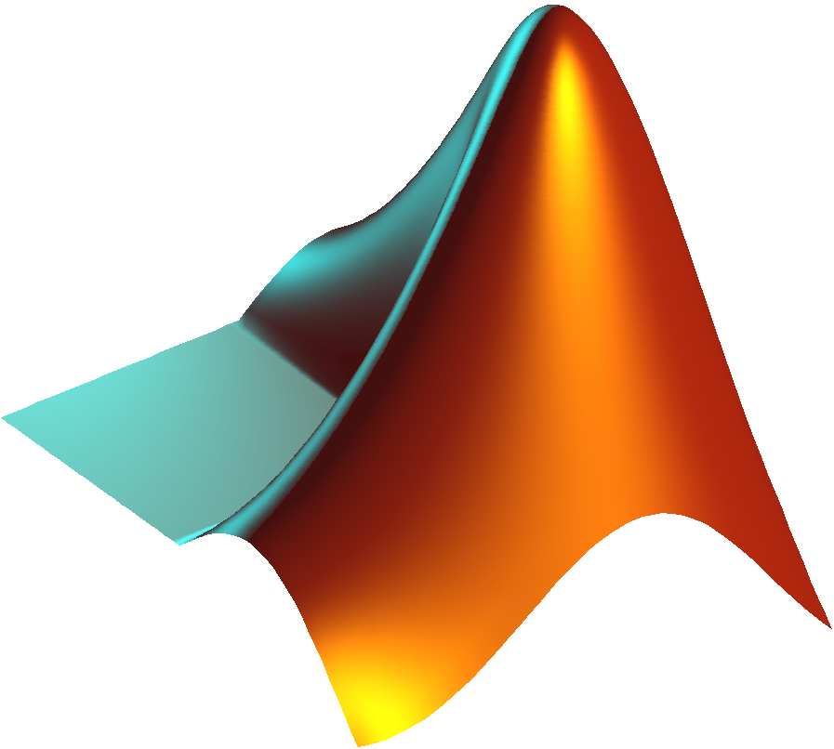

Mathematical Morphological (MM) Operations on Images
Mikołaj Leszczuk, Andrzej Matiolański

Slide 2
Mathematical Morphological (MM) Operations in Images
Theory/technique for analysis/processing of geometrical structures, based on:
Set theory
Lattice theory
Topology
Random functions
Foundation of basic MM operators to transform images:
Erosion
Dilation
Opening
Closing

Slide 3
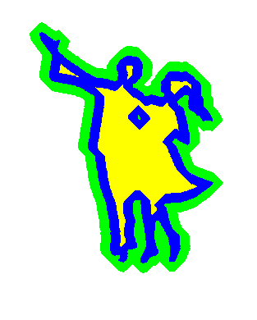
Shape (Blue) and Its Morphological Dilation (Green) and Erosion (Yellow)

Slide 4
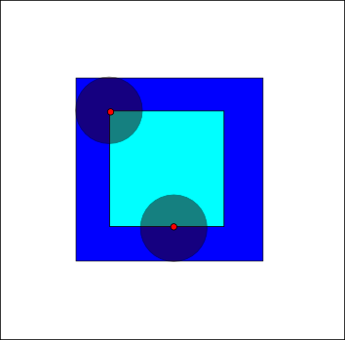
Erosion
1 of 2 fundamental operations in MM
Other being dilation
Basis for other MM operations
Example:
Erosion of dark-blue square by disk
Resulting in light-blue square
Application: thinner lines
“Erosion” by Renatokeshet at the English language Wikipedia. Licensed under CC BY-SA 3.0 via Commons – https://commons.wikimedia.org/wiki/File:Erosion.png#/media/File:Erosion.png
Notes:
Only when the structuring element is completely contained inside an area the pixel values are retained, otherwise they get deleted (zeroed) or, in other words, eroded.

Slide 5
Example of Erosion on Grayscale Image
Using a 5x5 flat structuring element
Top figure demonstrates application of structuring element window to individual pixels of original image
Bottom figure shows resulting eroded image
By Greg Insana - Own work, CC BY-SA 4.0, https://commons.wikimedia.org/w/index.php?curid=58367668
Notes:
Just choose a neighbouring pixel with the smallest value (the neighbourhood is defined by the structuring element). This is true as long as we use a flat structuring element (a value of 0 wherever the structuring element is defined and -inf everywhere else).

Slide 6
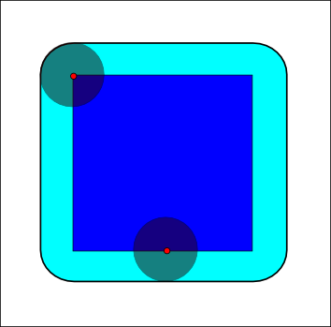
Dilation
1 of basic operations in MM
Using structuring element (here: disk)
Probing/expanding shapes contained in input image
Example:
Dilation of dark-blue square by disk
resulting in light-blue square with rounded corners
Application: thicker lines
Notes:
Superimpose the structuring element wherever there are active pixels (pixels of a binary image with a value of 1). Activate all pixels that fall below the superimposed structuring element.

Slide 7
Example of Dilation on Grayscale Image
Using a 5x5 flat structuring element
Top figure demonstrates application of structuring element window to individual pixels of original image
Bottom figure shows resulting dilated image
By Greg Insana - Own work, CC BY-SA 4.0, https://commons.wikimedia.org/w/index.php?curid=58367668
Notes:
Just choose a neighbouring pixel with the highest value (the neighbourhood is defined by the structuring element). This is true as long as we use a flat structuring element (a value of 0 wherever the structuring element is defined and -inf everywhere else).

Slide 8
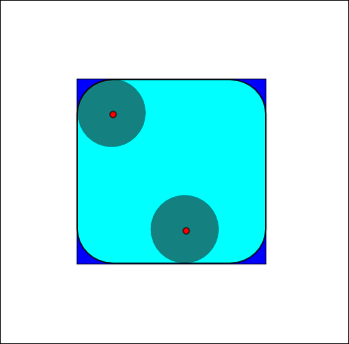
Opening
Dilation of erosion by structuring element
Example:
Opening of dark-blue square by disk
Resulting in light-blue square with round corners
Application: removing small objects
Notes:
First erode, then dilate.

Slide 9
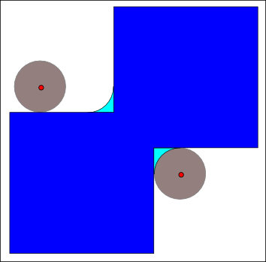
Closing
Erosion of dilation by structuring element
Example:
Closing of dark-blue shape by disk
Union of 2 squares
Resulting in:
Union of dark-blue shape, and
Light-blue areas
Application: removing small holes
Notes:
First dilate, then erode.

Slide 10
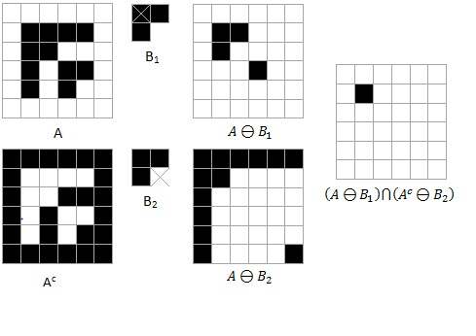
Hit-or-Miss Transform
Detecting, in binary image, given:
Configuration, or
Pattern
Using:
Morphological erosion operator, and
Pair of disjoint structuring elements
Result – set of positions, where:
1st structuring element fitting in foreground of input image and
2nd structuring element missing it completely
Notes:
A natural application is pattern recognition

Slide 11
Hit-or-Miss Transform
- a center of a structuring element
Notes:
The structuring elements are disjoin - notice their centers

Slide 12

(Topological) Image Skeleton
Thinner version of shape/binary image
Equidistant to its boundaries
Morphological skeleton
Skeleton computed by morphological operators
Example:
Shape and its skeleton
Made with algorithm preserving topology
Notes:
Some skeletons can be used to reconstruct the original shape
Equidistant means here there is more than one closes point on the shape boundary (from the perspective of a skeleton)
Used in biology to recognise shapes

Slide 13
(Topological) Image Skeleton cont.
Applications
Fingerprints scanning
Optical Character Recognition (OCR)
Compression
Protein folding analysis
Notes:
Some skeletons can be used to reconstruct the original shape
Equidistant means here there is more than one closest point on the shape boundary (from the perspective of a skeleton)
Used in biology to recognise shapes

Slide 14
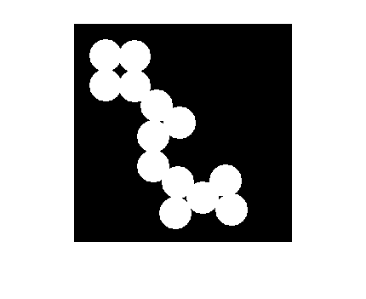
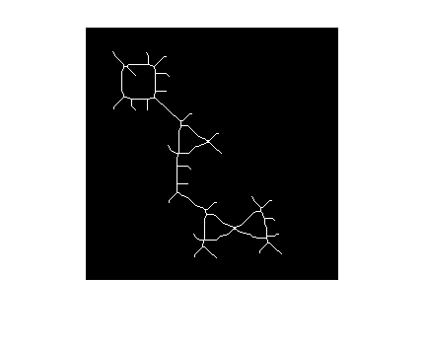
MATLAB Examples of Binary Image and Its Image Skeleton

Slide 15
Contours (Edges) Finding (Detection)
Set of mathematical methods aiming at identifying discontinuity points
Discontinuity points – where image brightness changes sharply
These points typically organized into a set of curved line segments (edges)
Similar to:
Step detection (1D signals)
Change detection (time signals)
Fundamental tool in:
Image processing
Machine/computer vision

Slide 16

Contours (Edges) Finding (Detection) Example
Canny edge detection
Applied to photograph
Applications:
Feature detection
Feature extraction
“EdgeDetectionMathematica” by JonMcLoone (talk) – I (JonMcLoone (talk)) created this work entirely by myself.. Licensed under CC BY-SA 3.0 via Wikipedia – https://en.wikipedia.org/wiki/File:EdgeDetectionMathematica.png#/media/File:EdgeDetectionMathematica.png
Notes:
Feature detection - finding points which are somehow “special”
Feature extraction - computing a descriptor from pixels surrounding the “special” point

Slide 17
Distance Transform
Labelling each pixel of an image with a distance to the nearest obstacle pixel
Most common type of an obstacle pixel – boundary pixel in a binary image
Usually qualified with a chosen metric

Slide 18
Common Metrics
Euclidean distance:
Euclidean metric
Pythagorean metric
L² norm
L² distance
Taxicab geometry:
City block distance
Manhattan distance
Manhattan length
Rectilinear distance
L¹ norm
L¹ distance
Chebyshev distance:
Tchebychev distance
Maximum distance
Chessboard distance
L∞ norm
L∞ distance

Slide 19
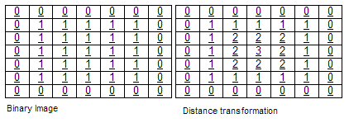
Euclidean Distance
Distance between 2 points
In Euclidean space
Ordinary distance – i.e. straight-line
“Distance Transformation”. Licensed under CC BY-SA 3.0 via Wikipedia - https://en.wikipedia.org/wiki/File:Distance_Transformation.gif#/media/File:Distance_Transformation.gif

Slide 20
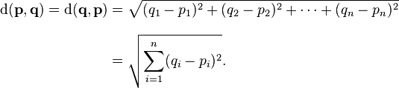
Euclidean Distance
d() - euclidean distance measure
q₁, q₂, …, q_{n} - coordinates of point q along the first, second, … and n^{th} dimension

Slide 21
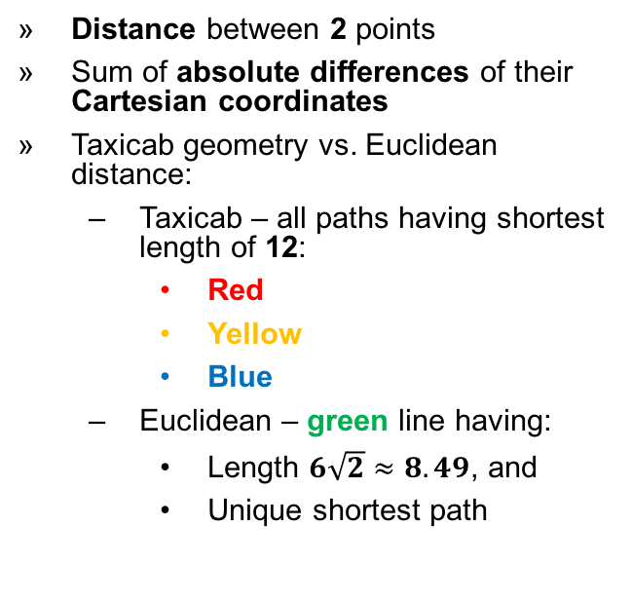
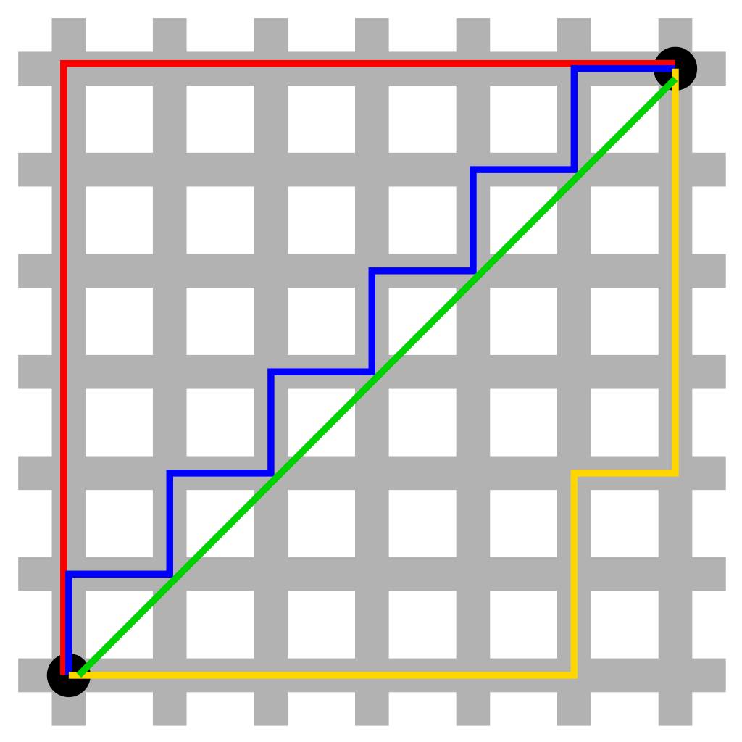
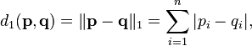
Taxicab Geometry

Slide 22
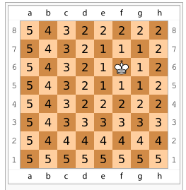

Chebyshev Distance
Distance between 2 vectors
Max of differences along any dimension
Chess board example
Minimum number of required king moves
Figure: distances of each square from f6
Notes:
Just take any dimension along which the coordinates differ most.

Slide 23
Thank You for Your Attention!
Explain the mathematical notation in the practical instruction

